Slide 1
Maxent
Implements “Maximum Entropy” modeling
  Entropy = randomness
  Maximizes randomness by removing patterns
  The pattern is the response
Website with papers:
  http://www.cs.princeton.edu/~schapire/maxent/

Slide 2
Overall Definitions
Overall area used to create the model:
  Sample area, area-of-interest (AOI), background
Locations where species was observed:
  Occurrences, presence points, observations
Environmental predictors:
  Covariates, independent variables
Probability density function:
  A function showing the probably of values for a covariate
  Area under the function must equal 1

Slide 3
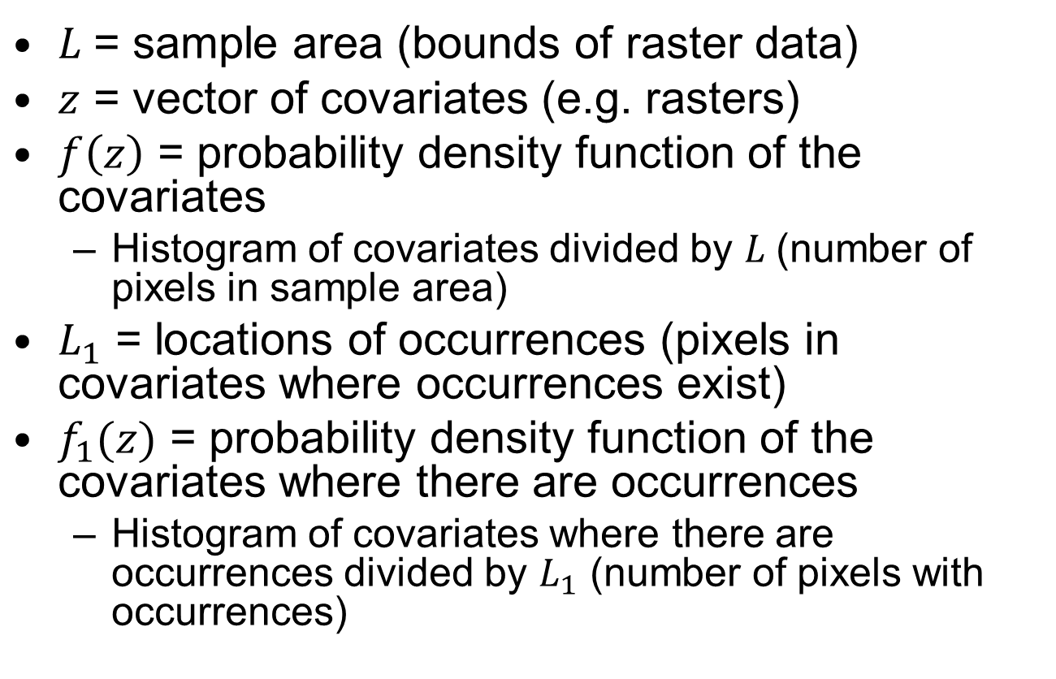
Definitions
$L$= sample area (bounds of raster data)
$z$ = vector of covariates (e.g. rasters)
$f\left(z\right)$ = probability density function of the covariates
  Histogram of covariates divided by $L$(number of pixels in sample area)
$L_{1}$ = locations of occurrences (pixels in covariates where occurrences exist)
$f_{1}(z)$ = probability density function of the covariates where there are occurrences
  Histogram of covariates where there are occurrences divided by $L_{1}$ (number of pixels with occurrences)

Slide 4


Relationships of histograms to probability distributions
N
Histogram of all
covariate values
$$f\left(z\right)∗L$$
$$f_{1}\left(z\right)∗L_{1}$$
Histogram of
covariate values
at occurrences
Frequency
0
Min
Covariate (precip, temp, aspect, distance from…)
Max

Slide 5

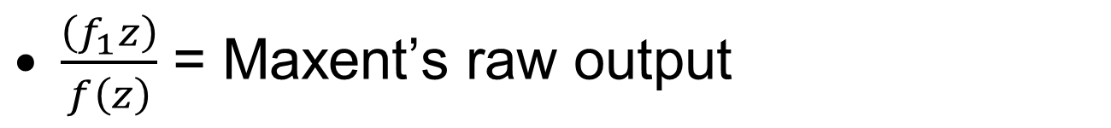
Densities
$\frac{\left(f_{1}z\right)}{f\left(z\right)}$ = Maxent’s raw output
1
$$\frac{f_{1}\left(z\right)}{f\left(z\right)}$$
Highest density of occurrences
(best habitat)
No occurrences
(not habitat)
0
Min
Covariate (precip, temp, aspect, distance from…)
Max

Slide 6
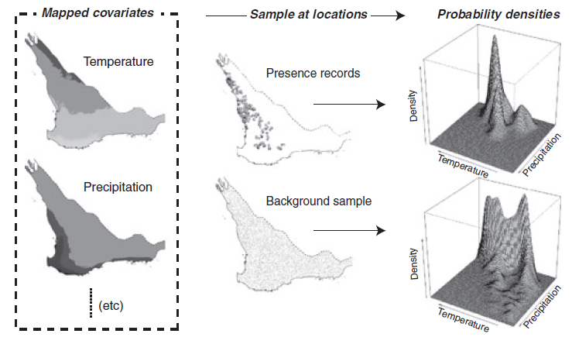
Densities
From Elith et. al.

Slide 7
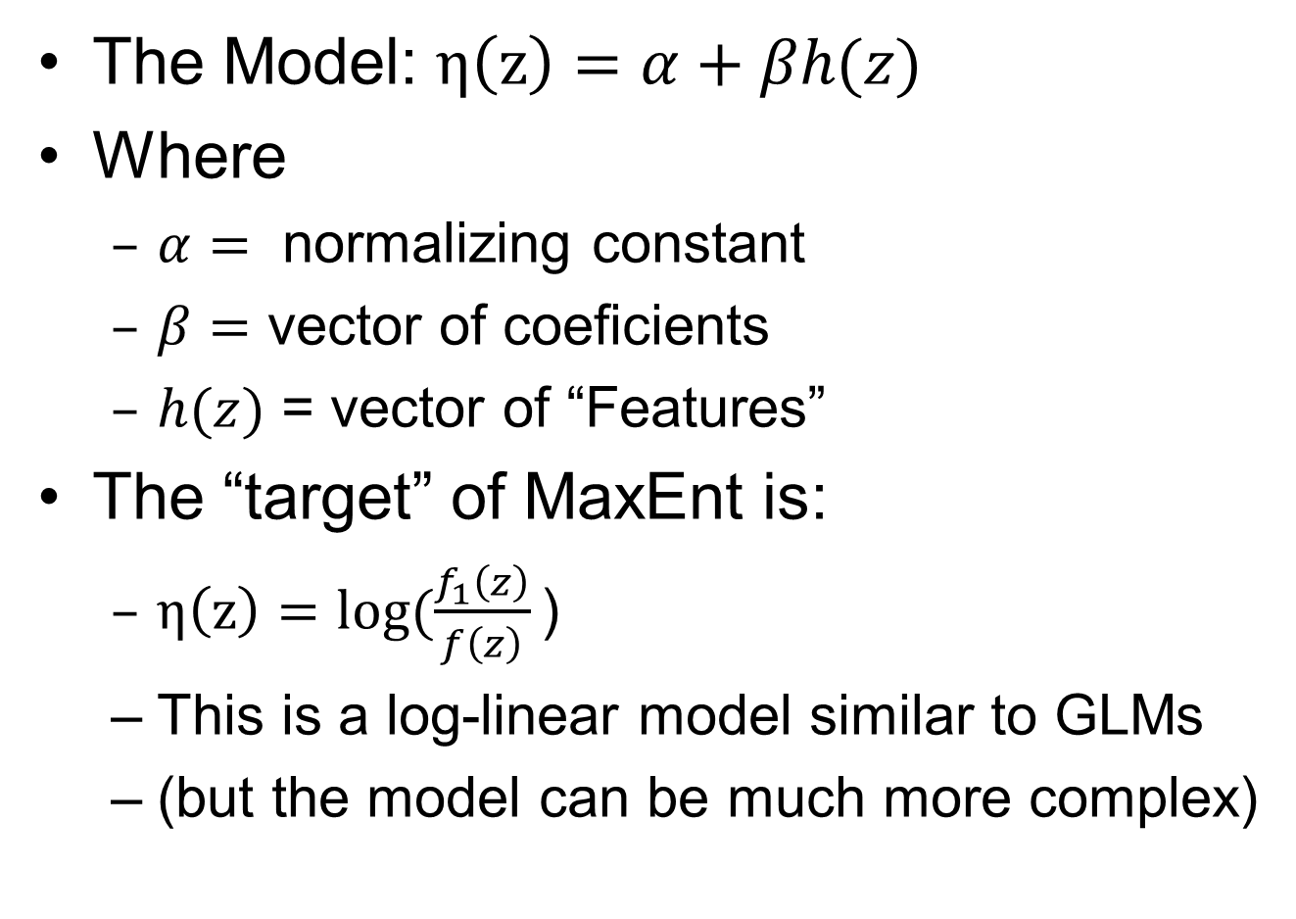
MaxEnt’s “Model”
The Model: $η\left(z\right)=α+βh(z)$
Where
  $α=$ normalizing constant
  $β=$ vector of coeficients
  $h(z)$ = vector of “Features”
The “target” of MaxEnt is:
  $η\left(z\right)=log⁡(\frac{f_{1}\left(z\right)}{f\left(z\right)}\text{)}$
  This is a log-linear model similar to GLMs
  (but the model can be much more complex)

Slide 8
MaxEnt Optimizes “Gain”
“Gain in MaxEnt is related to deviance”
  See Phillips in the tutorial
MaxEnt generates a probability distribution of pixels in the grid starting at uniform and improving the fit to the data
“Gain indicates how closely the model is concentrated around presence samples”
  Phillips

Slide 9
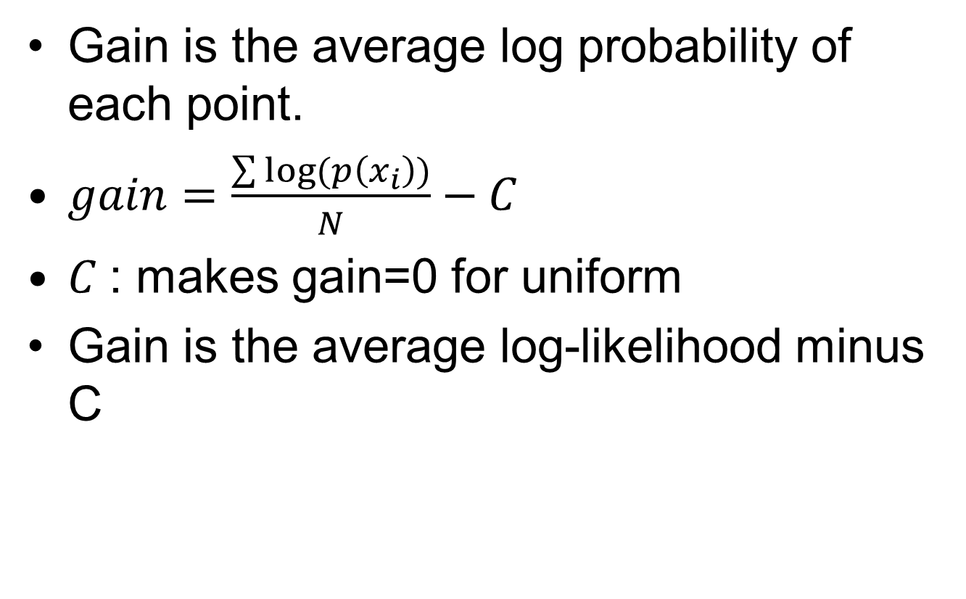
Gain
Gain is the average log probability of each point.
$gain=\frac{\sum{log⁡(p\left(x_{i}\right))}}{N}−C$
$C$: makes gain=0 for uniform
Gain is the average log-likelihood minus C

Slide 10
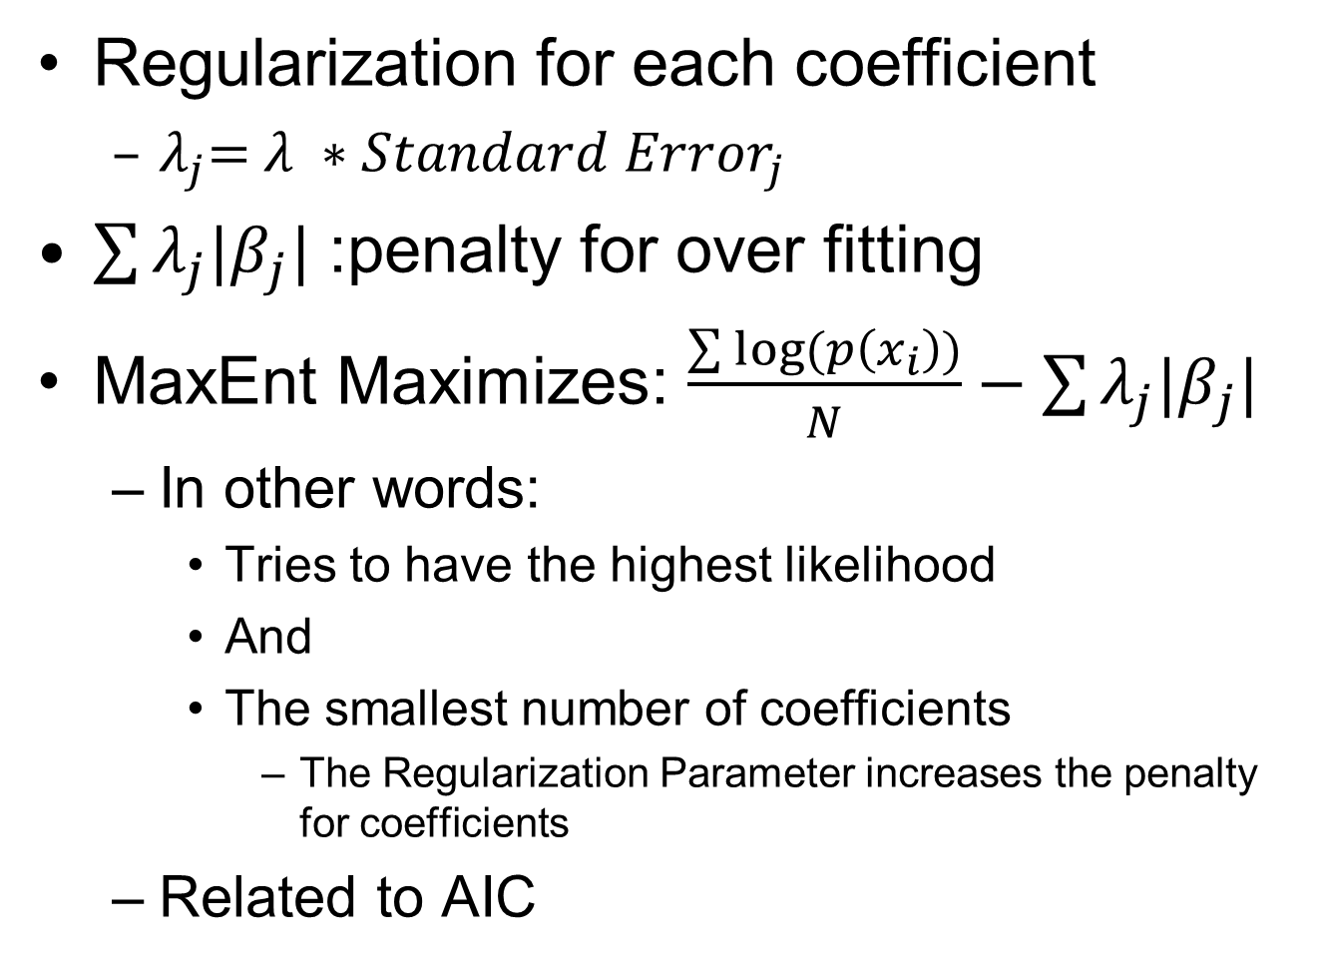
Regularization
Regularization for each coefficient
  $λ_{j}\text{=} λ ∗{Standard Error}_{j}$
$\sum{λ_{j}|β_{j}|}$ :penalty for over fitting
MaxEnt Maximizes: $\frac{\sum{log⁡(p\left(x_{i}\right))}}{N}−\sum{λ_{j}|β_{j}|}$
  In other words:
    Tries to have the highest likelihood
    And
    The smallest number of coefficients
      The Regularization Parameter increases the penalty for coefficients
  Related to AIC

Slide 11
Background Points
10,000 random points (default)
Uses all pixels if <10,000 samples

Slide 12
MaxEnt really…
MaxEnt tries to create a probability surface in hyperspace where:
  Values are near 1.0 where there are lots of points
  Values are near 0.0 where there are few or no points

Slide 13
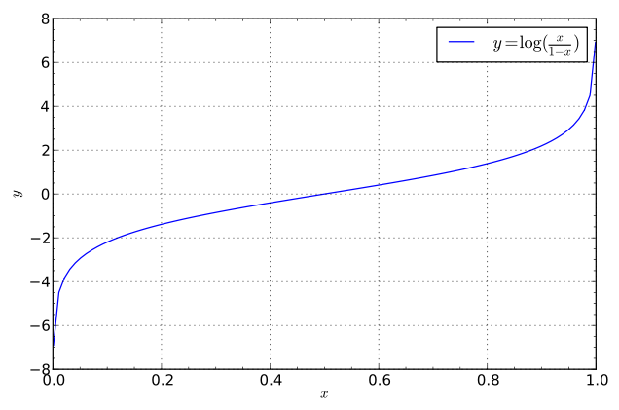
Logit – Inverse of Logistic

Slide 14
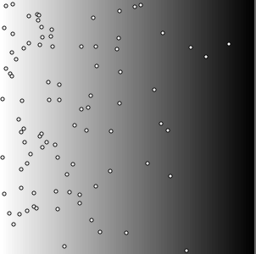
Synthetic Habitat & Species
Notes:
This method allows us to view what is happening in hyperspace and geographic space simultaneously and relate them

Slide 15
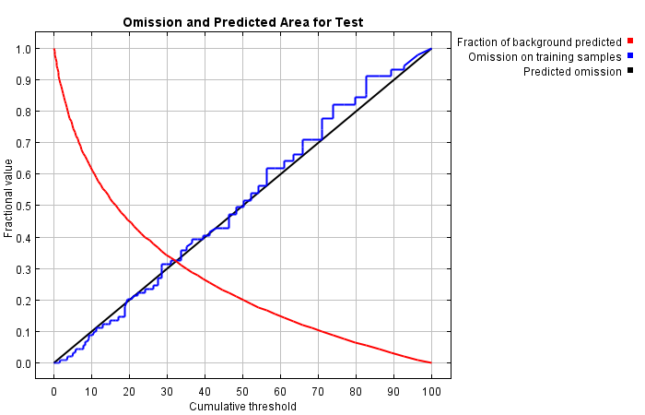
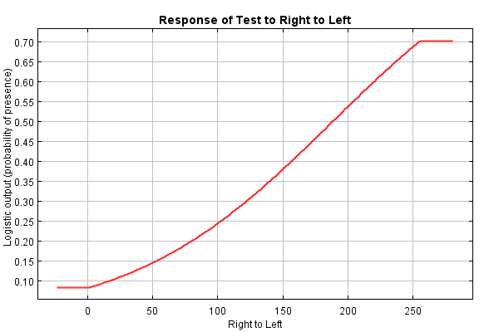
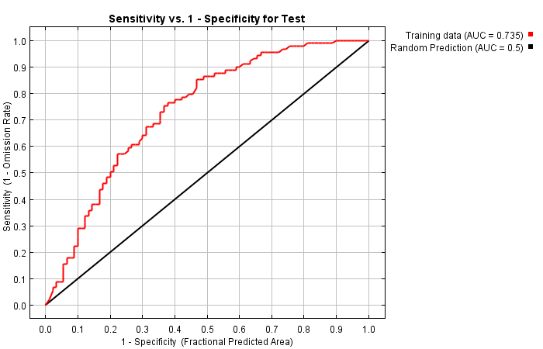
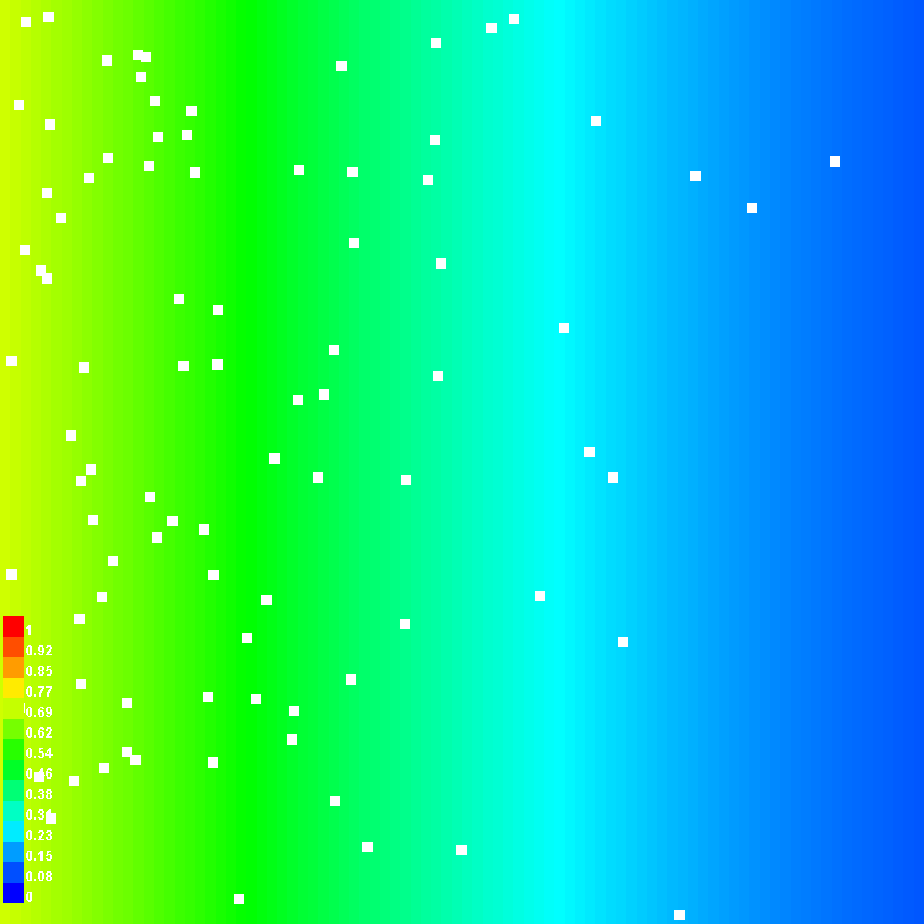
MaxEnt Outputs

Slide 16
Threshold~0.5
Threshold~0.2
Threshold~0.0
Notes:
Thresholding

Slide 17
Cumulative Threshold
All points omitted for no area
Threshold of 0 = Entire area
Threshold of 100% = no area
No omission for entire area
Notes:
Shows how well sample points are included as threshold changes

Slide 18
Definitions
Omission Rate: Proportion of points left out of the predicted area for a threshold
Sensitivity: Proportion of points left in the predicted area
  1 – Omission Rate
Fractional Predicted Area:
  Proportion of area within the thresholded area
Specificity: Proportion of area outside the thresholded area
  1 – Fractional Predicted Area:

Slide 19
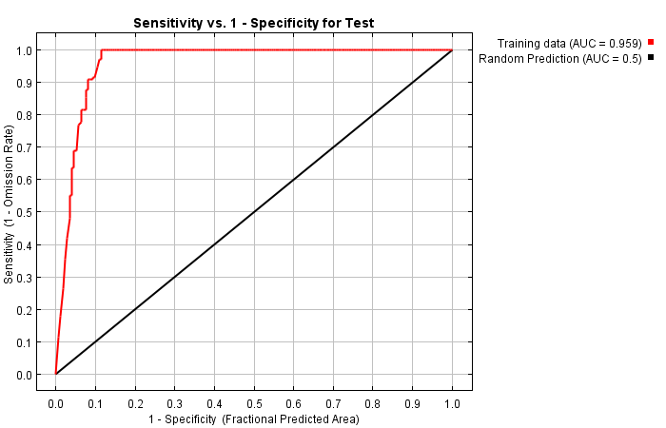
Receiver-Operator Curve (ROC)
Area Under The Curve (AUC)

Slide 20
What proportion of the sample points are within the thresholded area
Goes up quickly if points are within a sub-set of the overall predictor values
What proportion of the total area is within the thresholded area

Slide 21
AUC
Area Under the Curve
0.5=Model is random, Closer to 1.0 the better

Slide 22
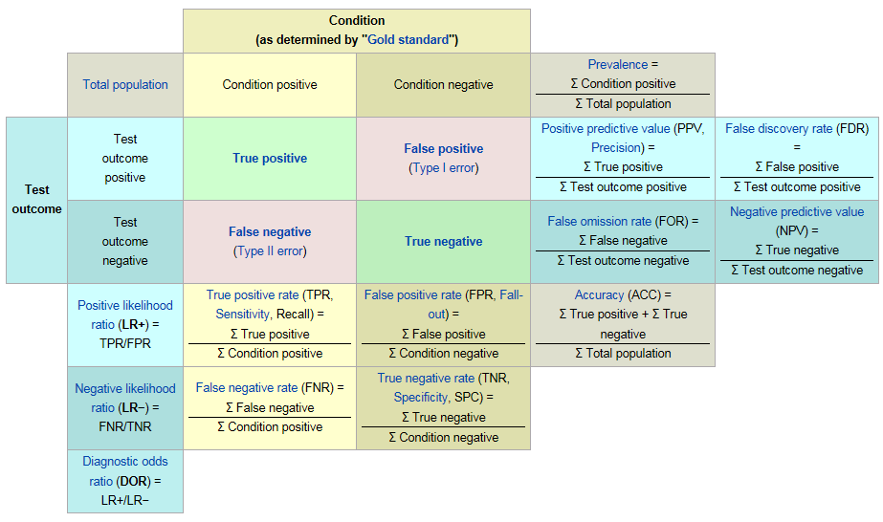
Best Explanation Ever!
http://en.wikipedia.org/wiki/Receiver_operating_characteristic

Slide 23
Fitting Features
Types of “Features”
  Threshold: flat response to predictor
  Hinge: linear response to predictor
  Linear: linear response to predictor
  Quadratic: square of the predictor
  Product: two predictors multiplied together
  Binary: Categorical levels
The following slides are from the tutorial you’ll run in lab

Slide 24
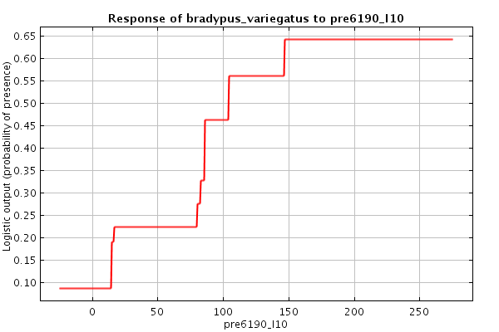
Threshold Features

Slide 25
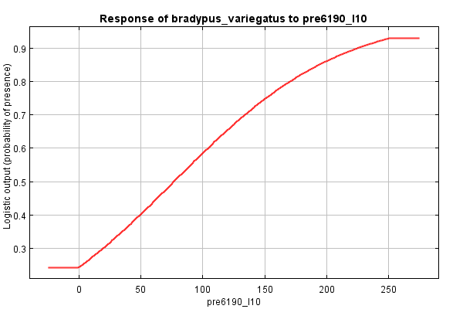
Linear
Notes:
Linear regression

Slide 26
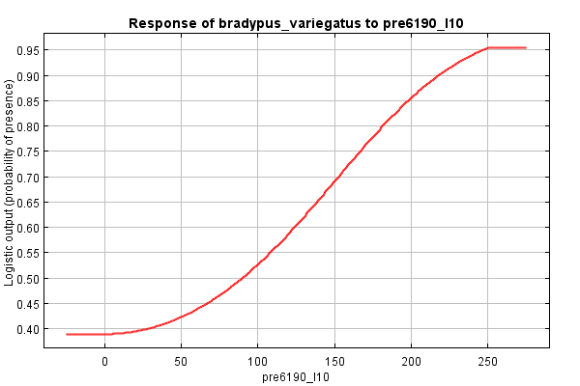
Quadratic
Notes:
Square of one of the predictors

Slide 27
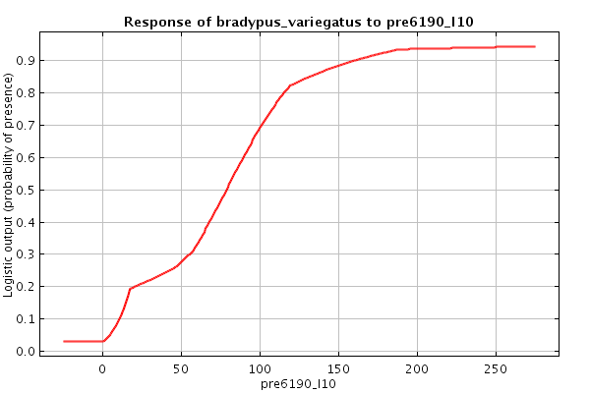
Hinge Features
Notes:
Hinge features are piece-wise linear segments. They appear somewhat curved because MaxEnt applies a logisitic function. Similar to linear but thresholded below a value

Slide 28
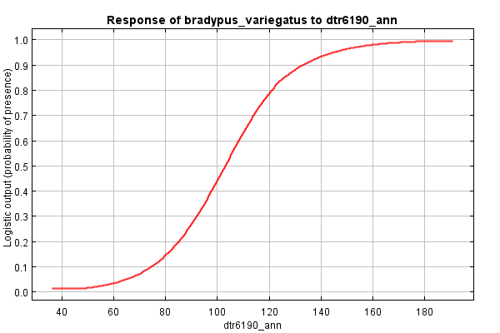
Product Features
Notes:
Modeled with the product of environmental variables

Slide 29
Getting the “Best” Model
AUC does not account for the number of parameters
  Use the regularization parameter to control over-fitting
MaxEnt will let you know which predictors are explaining the most variance
  Use this, and your judgment to reduce the predictors to the minimum number
  Then, rerun MaxEnt for final outputs

Slide 30
Number of Parameters
cld6190_ann, 0.0, 32.0, 84.0
dtr6190_ann, 0.0, 49.0, 178.0
ecoreg, 0.0, 1.0, 14.0
frs6190_ann, -1.1498818281061252, 0.0, 235.0
h_dem, 0.0, 0.0, 5610.0
pre6190_ann, 0.0, 0.0, 204.0
pre6190_l1, 0.0, 0.0, 185.0
pre6190_l10, 0.0, 0.0, 250.0
pre6190_l4, 0.0, 0.0, 188.0
pre6190_l7, 0.0, 0.0, 222.0
tmn6190_ann, 0.0, -110.0, 229.0
tmp6190_ann, 0.5804254993432195, 1.0, 282.0
tmx6190_ann, 0.0, 101.0, 362.0
vap6190_ann, 0.0, 1.0, 310.0
tmn6190_ann^2, 1.0673168197973097, 0.0, 52441.0
tmx6190_ann^2, -4.158022614271723, 10201.0, 131044.0
vap6190_ann^2, 0.8651171091826158, 1.0, 96100.0
cld6190_ann*dtr6190_ann, 1.2508669203612586, 2624.0, 12792.0
cld6190_ann*pre6190_l7, -1.174755465148628, 0.0, 16884.0
cld6190_ann*tmx6190_ann, -0.4321445358008761, 3888.0, 28126.0
cld6190_ann*vap6190_ann, -0.18405049411034943, 38.0, 25398.0
dtr6190_ann*pre6190_l1, 1.1453859981618322, 0.0, 19240.0
dtr6190_ann*pre6190_l4, 4.849148645354156, 0.0, 18590.0
dtr6190_ann*tmn6190_ann, 3.794041694656147, -16789.0, 23843.0
ecoreg*tmn6190_ann, 0.45809862608857377, -1320.0, 2290.0
ecoreg*tmx6190_ann, -1.6157434815320328, 154.0, 3828.0
ecoreg*vap6190_ann, 0.34457033151188204, 12.0, 3100.0
frs6190_ann*pre6190_l4, 2.032039282175344, 0.0, 6278.0
frs6190_ann*tmp6190_ann, -0.7801709867413774, 0.0, 15862.0
frs6190_ann*vap6190_ann, -3.5437330369989097, 0.0, 11286.0
h_dem*pre6190_l10, 0.6831004745857797, 0.0, 332920.0
h_dem*pre6190_l4, -7.446077252168424, 0.0, 318591.0
pre6190_ann*pre6190_l7, 1.5383313604986337, 0.0, 39780.0
pre6190_l1*vap6190_ann, -2.6305122968909807, 0.0, 47495.0
pre6190_l10*pre6190_l4, -2.5355630131828004, 0.0, 47000.0
pre6190_l10*pre6190_l7, 5.413839860312993, 0.0, 48750.0
pre6190_l10*tmn6190_ann, 1.2055688090972252, -1407.0, 54500.0
pre6190_l4*pre6190_l7, -3.172491547290633, 0.0, 36660.0
pre6190_l4*tmn6190_ann, -1.2333164353879962, -1463.0, 40984.0
pre6190_l4*vap6190_ann, -0.6865648521426311, 0.0, 55648.0
pre6190_l7*tmp6190_ann, -0.45424195658031474, 0.0, 55278.0
pre6190_l7*tmx6190_ann, -0.23195173539212843, 0.0, 68598.0
tmn6190_ann*tmp6190_ann, 0.733594398523686, -6300.0, 64014.0
tmn6190_ann*vap6190_ann, 1.414888294903485, -3675.0, 70074.0
(85.5<pre6190_l10), 0.7526049605127942, 0.0, 1.0
(22.5<pre6190_l7), 0.09143627960137418, 0.0, 1.0
(14.5<pre6190_l7), 0.3540139414522918, 0.0, 1.0
(101.5<tmn6190_ann), 0.5021949716276776, 0.0, 1.0
(195.5<h_dem), -0.4332023993069761, 0.0, 1.0
(340.5<tmx6190_ann), -1.4547597256316012, 0.0, 1.0
(48.5<h_dem), -0.1182394373335682, 0.0, 1.0
(14.5<pre6190_l10), 1.4894000152716946, 0.0, 1.0
(308.5<tmx6190_ann), -0.5743766711031515, 0.0, 1.0
(311.5<tmx6190_ann), -0.19418359220467488, 0.0, 1.0
(23.5<pre6190_l4), 0.6810910505907158, 0.0, 1.0
(9.5<ecoreg), 0.7192087537708799, 0.0, 1.0
(281.5<tmx6190_ann), -1.2177451449751997, 0.0, 1.0
(50.5<h_dem), -0.2041650979073212, 0.0, 1.0
'tmn6190_ann, 2.506694714713521, 228.5, 229.0
(36.5<h_dem), -0.04215558381842702, 0.0, 1.0
(191.5<tmp6190_ann), 0.8679225073207016, 0.0, 1.0
(101.5<dtr6190_ann), 0.0032675586724019226, 0.0, 1.0
'cld6190_ann, -0.009785185080653264, 82.5, 84.0
`h_dem, -1.0415514779720143, 0.0, 2.5
(1367.0<h_dem), -0.2128591450282928, 0.0, 1.0
(280.5<tmx6190_ann), -0.06975266984609022, 0.0, 1.0
(55.5<pre6190_ann), -0.3681568888568664, 0.0, 1.0
(211.5<h_dem), -0.09946657794871552, 0.0, 1.0
(82.5<pre6190_l10), 0.09831192008677023, 0.0, 1.0
(41.5<pre6190_l7), -0.07282871533190113, 0.0, 1.0
(86.5<pre6190_l1), -0.06404898712746389, 0.0, 1.0
(106.5<pre6190_l1), 0.9347973610811197, 0.0, 1.0
(97.5<pre6190_l4), 0.02588993095745272, 0.0, 1.0
`h_dem, 0.2975112175166992, 0.0, 57.5
`pre6190_l1, -1.4918629714740488, 0.0, 3.5
(87.5<pre6190_l1), -0.16210452683985327, 0.0, 1.0
`pre6190_l1, 0.6469706380585183, 0.0, 33.5
(199.5<vap6190_ann), 0.07974469741688692, 0.0, 1.0
`pre6190_l7, 0.6529517367541156, 0.0, 0.5
(985.0<h_dem), 0.5311126727361561, 0.0, 1.0
(12.5<pre6190_l7), 0.15147093558026073, 0.0, 1.0
'dtr6190_ann, 1.9102989446786593, 100.5, 178.0
(24.5<pre6190_l7), 0.22066203658397954, 0.0, 1.0
`h_dem, 0.19290062857835738, 0.0, 58.5
(95.5<pre6190_l4), 0.11847374533530691, 0.0, 1.0
(42.5<pre6190_l10), -0.22634502760604264, 0.0, 1.0
(59.5<cld6190_ann), -0.08833902526182105, 0.0, 1.0
(156.5<tmn6190_ann), -0.3949178282642713, 0.0, 1.0
'vap6190_ann, -0.09749601885757717, 284.5, 310.0
(195.5<pre6190_l10), -0.7064287716566797, 0.0, 1.0
'pre6190_ann, -0.13355287707153143, 198.5, 204.0
(85.5<pre6190_ann), -0.08639349917230135, 0.0, 1.0
`cld6190_ann, -0.8869579099922708, 32.0, 56.5
(127.5<pre6190_l7), 0.16433984792079512, 0.0, 1.0
(310.5<tmx6190_ann), -0.12187855649464616, 0.0, 1.0
(123.5<dtr6190_ann), -0.3879778631592106, 0.0, 1.0
(58.5<cld6190_ann), -0.045757294470318455, 0.0, 1.0
`h_dem, -0.03506780995851361, 0.0, 15.5
`dtr6190_ann, 0.8788733700181052, 49.0, 89.5
(34.5<pre6190_ann), -0.11675983810645604, 0.0, 1.0
`h_dem, -0.07042193156800028, 0.0, 16.5
(195.5<tmp6190_ann), -0.06201919461360444, 0.0, 1.0
linearPredictorNormalizer, 8.791343644655978
densityNormalizer, 129.41735442727088
numBackgroundPoints, 10112
entropy, 7.845994051976282
Notes:
From the Lambas file running with the default regularization for the tutorial

Slide 31
Running Maxent
Folder for layers:
  Must be in ASCII Grid “.asc” format
CSV file for samples:
  Must be: Species, X, Y
Folder for outputs:
  Maxent will put a number of files here

Slide 32
Avoiding Problems
Create a folder for each modeling exercise.
  Add a sub-folder for “Layers”
    Layers must have the same extent & number of rows and columns of pixels
  Save your samples to a CSV file:
    Species, X, Y as columns
  Add a sub-folder for each “Output”.
    Number or rename for each run
Some points may be missing environmental data

Slide 33
Running Maxent
Batch file:
  maxent.bat contents:
    java -mx512m -jar maxent.jar
  The 512 sets the maximum RAM for Java to use
Double-click on jar file
  Works, with default memory

Slide 34
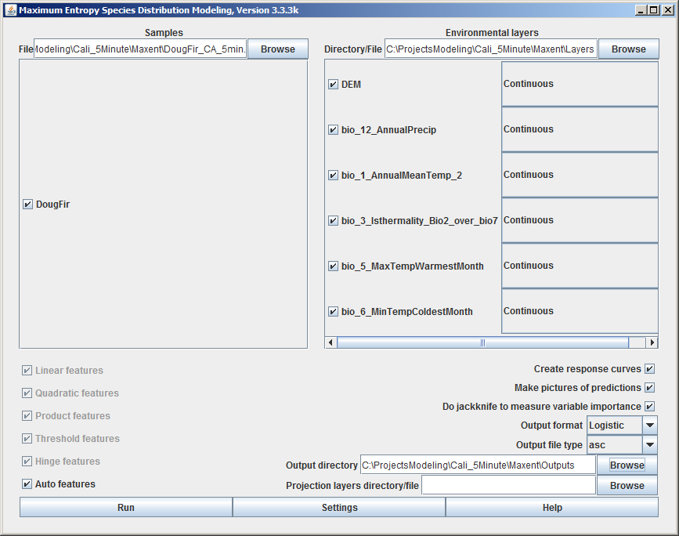
Maxent GUI

Slide 35
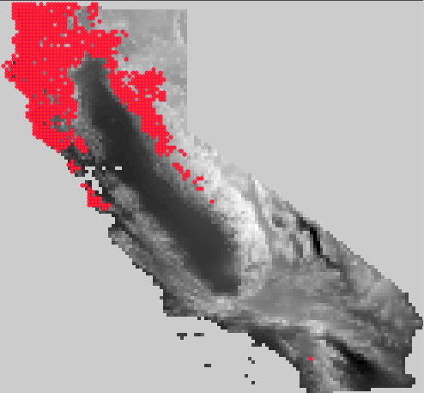
Douglas-Fir Points

Slide 36
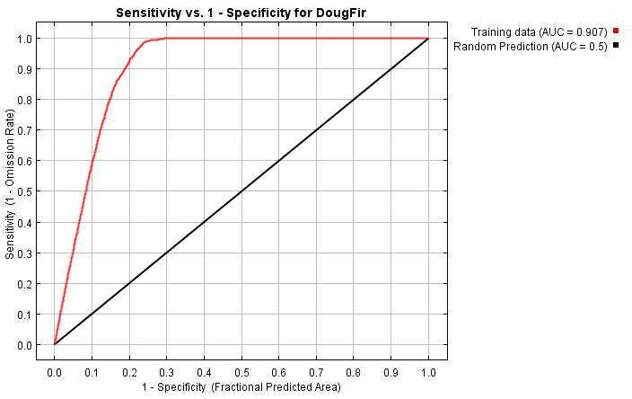
AUC Curve

Slide 37
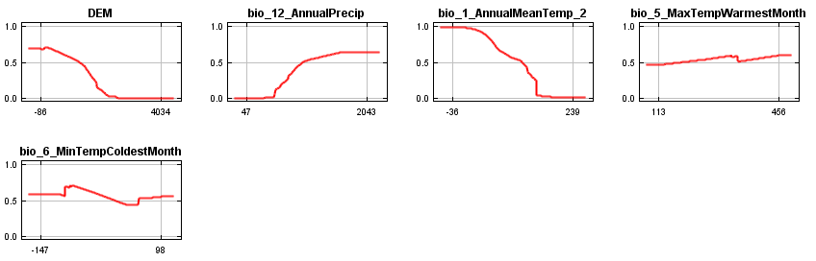
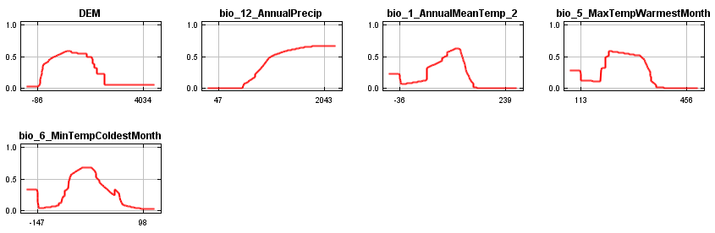
Response Curves
Each response if all predictors are used
Each response if only one predictor is used

Slide 38
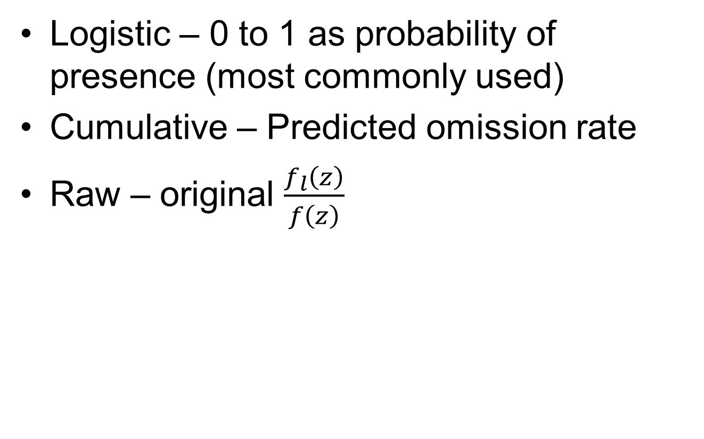
Surface Output Formats
Logistic – 0 to 1 as probability of presence (most commonly used)
Cumulative – Predicted omission rate
Raw – original $\frac{f_{l}\left(z\right)}{f\left(z\right)}$
Notes:
Logistic is the default and the most commonly used

Slide 39
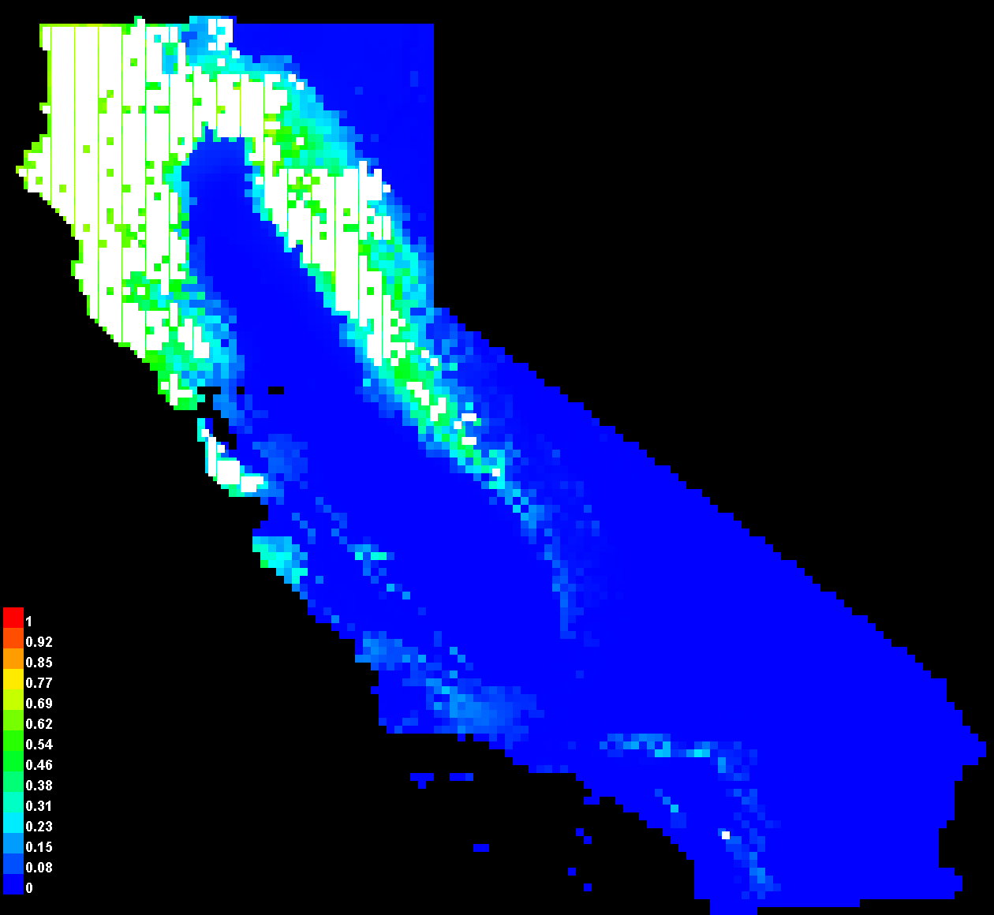

Slide 40
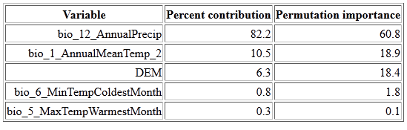
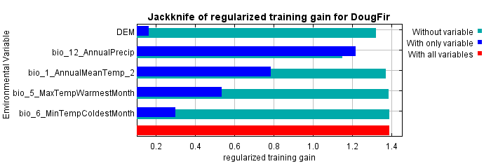
Percent Contribution
Precip. contributes the most

Slide 41
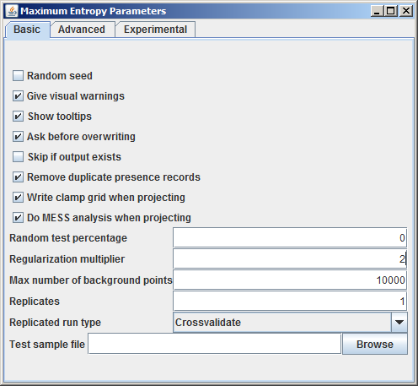
Settings

Slide 42
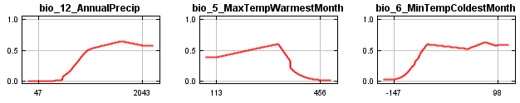
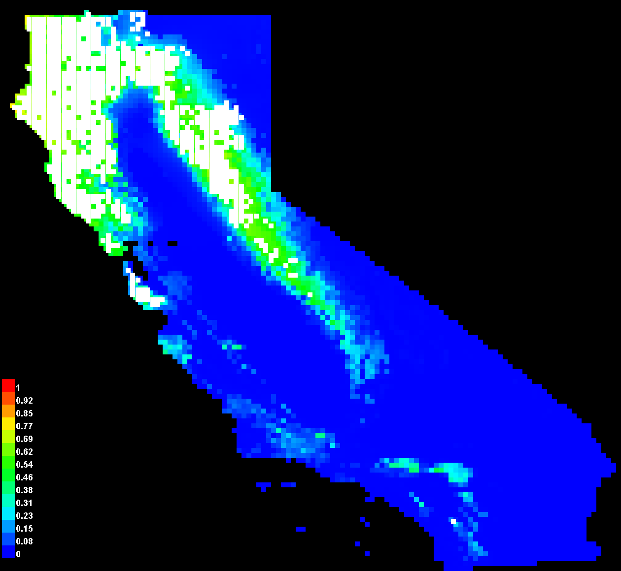
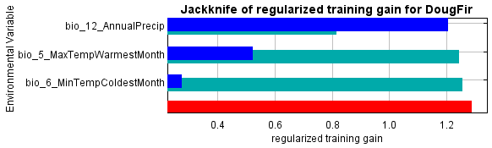
Regularization = 2
AUC = 0.9

Slide 43
Resampling Occurrences
MaxEnt Uses:
  Leave-one-out cross-validation (LOOCV)
    Break up data set into N “chucks”, run model leaving out each chunk
Replication: MaxEnt’s term for resampling

Slide 44
Optimizing Your Model
Select the “Sample Area” carefully
Use “Percent Contribution”, Jackknife and correlation stats to determine the set of “best” covariates
Try different regularization parameters to obtain response curves you are comfortable with and reduce the number of parameters (and/or remove features)
Run “replication” to determine how robust the model is to your data

Slide 45
Model Optimization & Selection
Modeling approach
Predictor Selection
Coefficients estimation
Validation:
  Against sub-sample of data
  Against new dataset
Parameter sensitivity
Uncertainty estimation

Slide 46
 | Linear | GAM | BRT | Maxent
Number of predictors | N | N | N | N
“Base” equation | Linear (or linearized) | Link + splines (typical) | Trees | Linear, product, threshold, etc.
Fitting approach | Direct analytic solution | Solve derivative for maximum likelihood | Make a tree, add one, if better, keep going | Search for best solution
Response variable | Continuous | Continuous | Continuous or categorical | Presence-only
Covariates | Continuous | Continuous or categorical | Continuous or categorical | Continuous or categorical
Uniform residuals | Yes | Yes | Yes | Yes
Independent samples | Yes | Yes | Yes | Yes
Complexity | Simple | Moderate | Complex | Complex
Over fit | No | Unlikely | Probably | Probably

